Slide 1
Final Exam Review

Slide 2
Contents
History of DB
Database, Users, Data Models, DB System (1,2)
Relational Model and its languages: ALG, TRC, DRC, SQL (5,6,7,8)
ER, EER and Normalization (3,4,9,14,15)
Database Programming: Embeded/Dynamic SQL, Transaction Processing, Concurrency Control and Recovery (20,22)

Slide 3
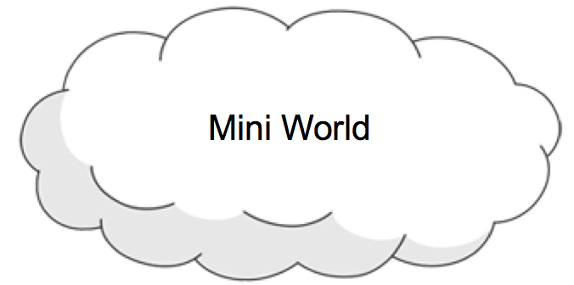





Database Applications
Application
Application
Database
Database

Slide 4
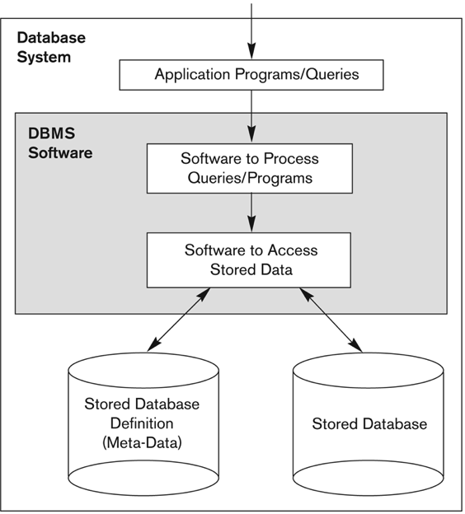
Database System
C,Java,SQLJ
Application
Database

Slide 5
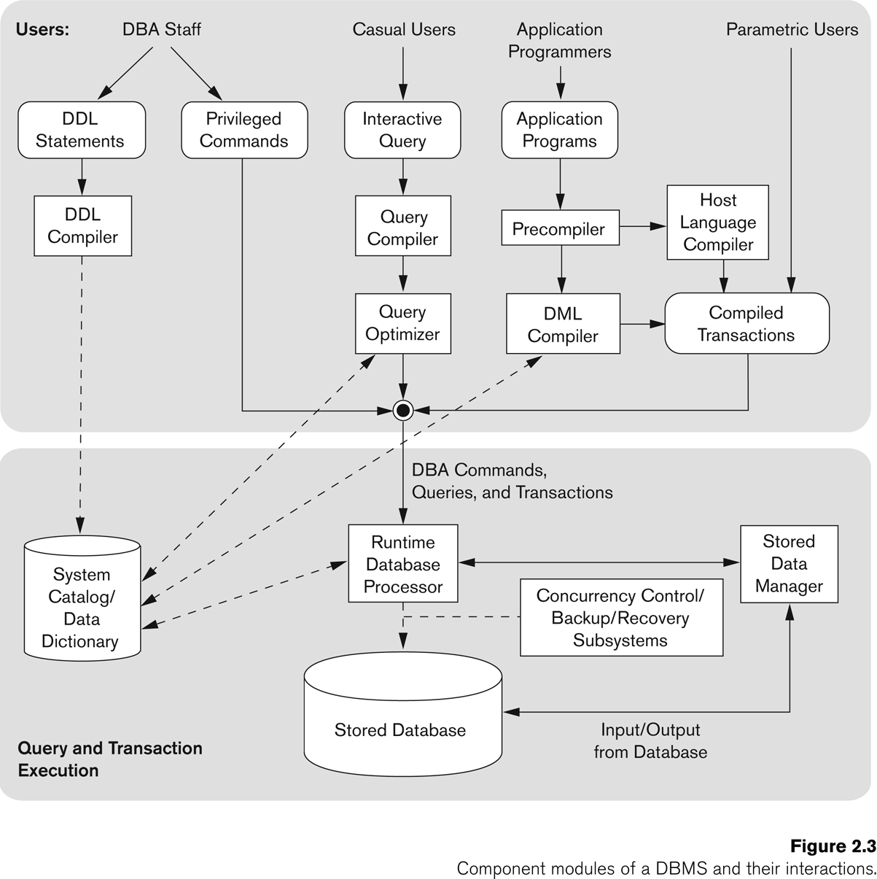
End Users

Slide 6
Database System Architecture
Physically Centralized Architecture
Client-Server Architecture

Slide 7
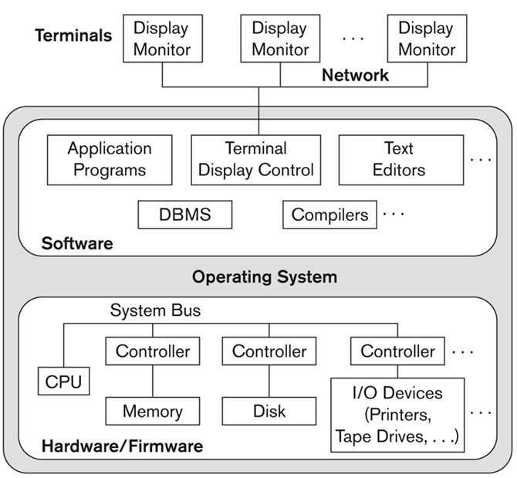
Physical Centralized Architecture

Slide 8
System Architecture
Client program opens a connection to the database server
Client program submits SQL to the server
When database access is no longer needed, client program closes (terminates) the connection
Application
Program
Client
SQL
SQL
Engine
Server
DB

Slide 9
Logical Two-Tier Architecture
Client
Client
SQL
Network
SQL
DBMS
Server

Slide 10
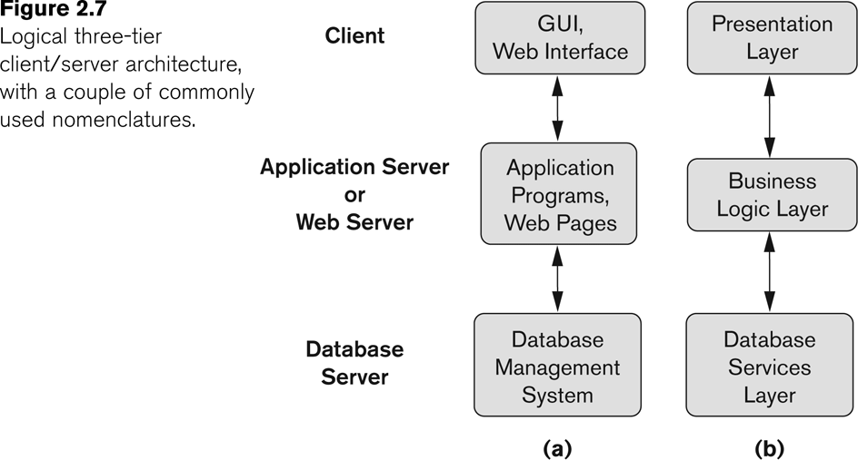
Three-Tier Client-Server architecture

Slide 11
Data Models
A data model specifies how data is structured and operated.
It consists of three parts:
a set of concepts to describe the structure of a database
a set of operations for manipulating these structures
a set of constraints that the database should obey.

Slide 12
Categories of Data Models
Physical (Low-level) data models:
Provide concepts that describe details of how data is stored in the computer: tracks, cylinders, indices
Conceptual (high-level, semantic) data models:
Provide concepts that are close to the way many users perceive data.
Entity Relationship Model
Object Relational Model
Implementation data models:
Provide concepts that fall between the above two, used by many commercial DBMS implementations
Hierarchical Model
Network Model
Relational Model

Slide 13
Hierarchical Model
The data is organized into a tree-like structure using records and links on disk rather than in memory
The data is stored as records which are collections of fields, with each field containing only one value. All attributes of a specific record are listed under an entity type.
Records are connected to one another through links.
Each record having one parent record and many children so that records' relationships form a tree-like model.
All attributes of a specific record are listed under an entity type.
This structure is simple but inflexible because the relationship is confined to a one-to-many relationship

Slide 14
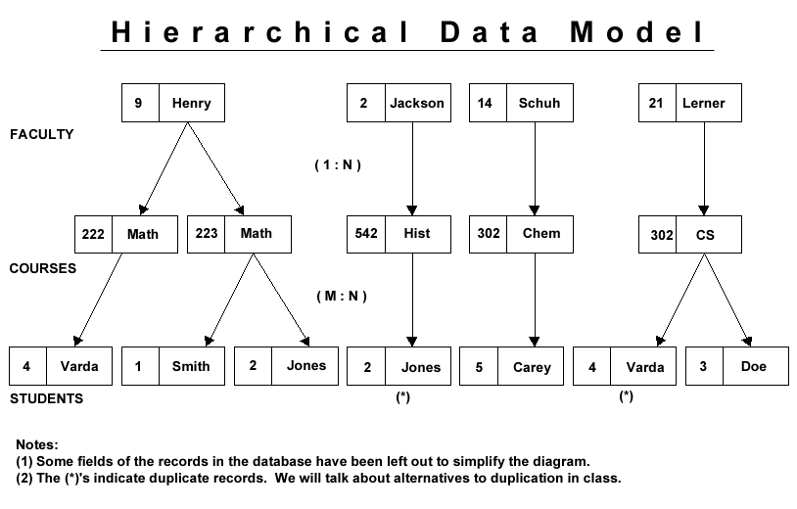
records
pointers
records
pointers

Slide 15
Hierarchical Model
Advantages:
Simple to construct and operate
Corresponds to a number of natural hierarchically organized domains, e.g., organization (“org”) chart
Language is simple:
Uses constructs like GET, GET UNIQUE, GET NEXT, GET NEXT WITHIN PARENT, etc.
Disadvantages:
Navigational and procedural nature of processing
Cannot capture the semantics of the data as Individual fields cannot identified by the system; a record is simply treated as a number of bytes into which data could be placed
Cannot represent many to many (M:N) relationships naturally
No data independence
Notes:
The purpose of a database management system is to
make life easier for the user and this is achieved by hiding
the complexities of the actual storage of the data from the
application software.
In a database system where true data
independence exists it is possible to restructure the physical
storage of data without invalidating any of the existing
applications.
Access to IMS data, for example, requires a programmer
to enter the database via a record at the top of the
hierarchy. If a programmer does not know which of the
top level records to select then the whole database must
be searched.

Slide 16
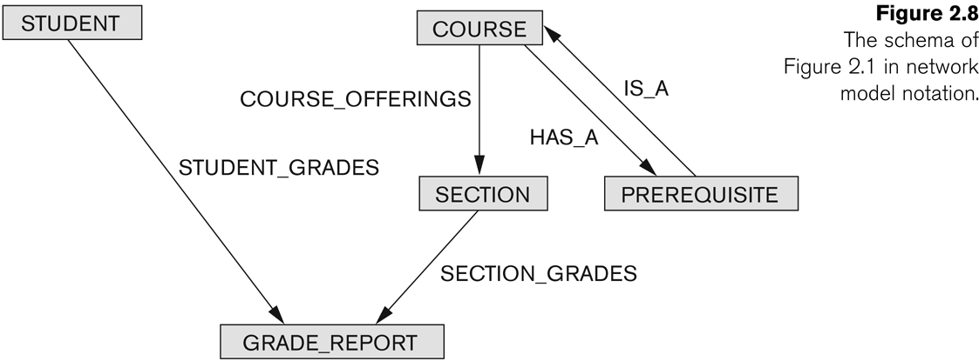
Network Model
The data is organized into a graph (lattice) structure.
each parent can have many children
each child can also have many parents.
N:M

Slide 17
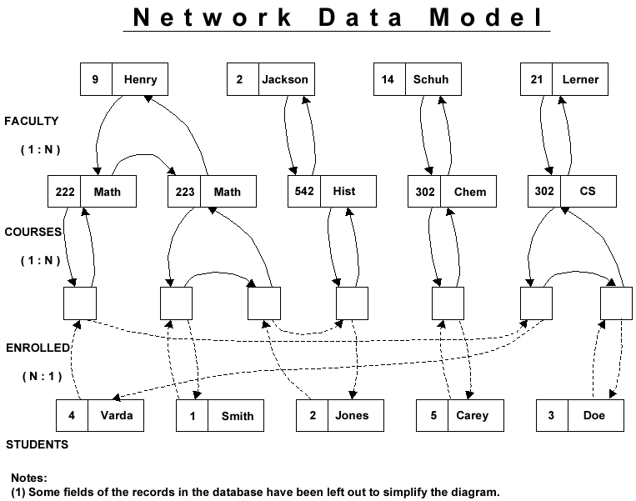
records
pointers
records
pointers
records
pointers
records

Slide 18
Network Model
Advantages:
Network Model is able to model complex relationships and represents semantics of add/delete on the relationships, especially N:M relationships
Can handle most situations for modeling using record types and relationship types.
Language is navigational; uses constructs like FIND, FIND member, FIND owner, FIND NEXT within set, GET, etc.
Programmers can do optimal navigation through the database.

Slide 19
Network Model
Disadvantages:
Navigational and procedural nature of processing
Database contains a complex array of pointers that thread through a set of records.
The semantics of data embedded in application programs and different sets of semantics could be applied by different applications.
Limited data independence
Little scope for automated “query optimization”
Notes:
Access to the database was typically performed on a record at a time basis with the programmer testing each
record retrieved to see whether or not it belonged in the result set.
CODASYL designers identify entry points to
the database via key hashing mechanisms or special relationships.

Slide 20
Relational Model
The need to increase data independence in data base system
to hide certain necessary storage and retrieval operations from the applications programmer
The need for a mathematical approach to data storage and retrieval
Just tell DBMS what to get rather than how to get
The need to support ad hoc query processing
Users can interactively submit a query and immediately receive an answer.
Notes:
both of hierarchical and network systems relied on the use of pointers between records, the programmers using them did not manipulate the pointers directly
The purpose of a database management system is to
make life easier for the user and this is achieved by hiding
the complexities of the actual storage of the data from the
application software
The user of a relational system is able to extract any results that follow from the
content of the raw data and not just those permitted by the database system. In order to facilitate this no aspect of a
relational system depends on the order in which the data is stored.
A specification was drawn up, this was transformed into a design and the design was used to construct a
program. This sequence, as everyone knows, is full of opportunities for introducing errors. It takes considerable
skill to write a program that performs correctly against a database and considerably more skill to demonstrate that the
program fulfils the requirements of the original specification.
This is equivalent to having an executable specification language.
The problem of ensuring that the query matches the real
world requirement remains but the problem of transforming
the query into executable code disappears.
Codd believed that users would no longer be satisfied with obtaining output
from a database on a daily basis following the off-line
execution of a query program, instead they would expect
to interactively submit a query and immediately receive an
answer. Provision of such a facility relies, to a certain
extent, on data independence and relational theory

Slide 21
Relational Model
FACULTY
F# | FNAME
2 | Jackson
9 | Henry
14 | Schuh
21 | Lerner
COURSES
C# | CNAME
222 | Math
223 | Math
302 | CS
302 | Chem
542 | Hist
STUDENT
S# | SNAME
1 | Smith
2 | Jones
3 | Doe
4 | Varda
5 | Carey
all data is represented in terms of tuples (records), grouped into relations (files)
FC
F# | C#
2 | 542
9 | 222
9 | 223
14 | 302
21 | 304
SC
S# | C#
1 | 223
2 | 223
2 | 542
3 | 304
4 | 222
4 | 304
5 | 302

Slide 22
Relational Model
Concepts:
Domain
Tuple
Attribute
Relation
Candidate key
Primary key
Foreigh key

Slide 23
Relational Model
Operations:
Algebra
project, select, join, union, ...
Calculus-based
Tuple calculus
Domain calculus , Query By Example (QBE)
SQL popular commercial language
a combination of algebraic and tuple calculus languages

Slide 24
Structured Query Language (SQL)
Industry standard DB language
Complete DB Language like QBE
DDL
DML
QL

Slide 25
Database Components
Database Schema
Database Instance

Slide 26
Database Schema vs. Database Instance
Distinction
The database schema changes very infrequently.
The database instance changes every time the database is updated.
Schema is also called intension.
Instance is also called extension.

Slide 27
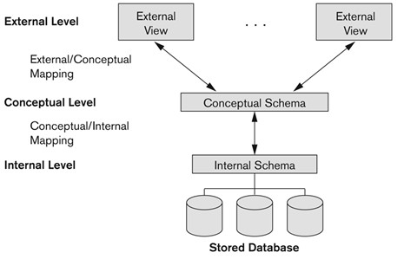
Three-Schema Architecture
Advantages:
multiple views of the data
Program-data independence.

Slide 28


How to create a database
Mini World
DB

Slide 29
Overview of Database Design Process
Two main activities:
Database design
Applications design
Focus in this chapter on database design
To design the conceptual schema for a database application
Applications design focuses on the programs and interfaces that access the database
Generally considered part of software engineering

Slide 30
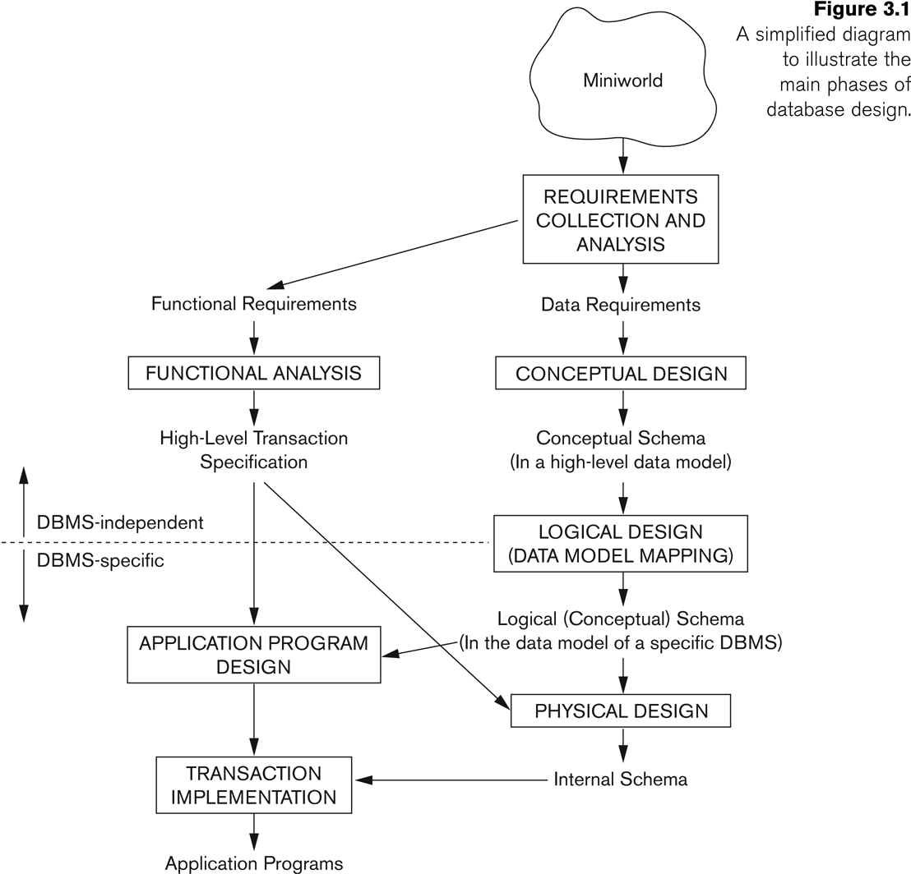
Overview of Database Design Process

Slide 31
ER Model
Entity Types
Regular Entity Types
Weak Entity Types
Relationship Types
Binary 1:1 Relation Types
Binary 1:N Relationship Types.
Binary M:N Relationship Types.
N-ary Relationship Types.
Weak Relationship Types
Properties
Entity Properties
Relationship Properties

Slide 32
Entity
A distinguishable object in the real world
(Strong) Entity set
can exist on its own in the DB and
has a key attribute
Weak entity set
has no key attribute and is dependent on its owner entity
has a partial key that can uniquely identify weak entities within its owner entity

Slide 33
Relationship
It relates two or more entities with a specific meaning
Participants: entities in the relationship
Kinds of Relationships
Regular
connect strong/weak entity sets (except its owner)
Weak
connect a weak entity set to its owner
Degree
The number of participants
binary two participants
n-ary n participants

Slide 34

Attribute
Information that describes an entity
Kinds:
Simple: age, gender
Composite: (street no, city, postcode), (Fname, Lname)
Single: age, gender
Multi-valued: children, friends
Base: quantity
Derived: total quantity
Key: property that uniquely identify the entity
Partial key: properties that can uniquely identify weak entities that are related to the same owner entity
First
Last
Name
S#
Name

Slide 35
Cardinality Constraints: Method 1
Cardinality ratio (of a binary relationship):
1:1,
1:N,
N:1,
N:N
Shown by placing appropriate numbers on the relationship edges.
Participation constraint (on each participating entity type): total (called existence dependency) or partial.
Total shown by double line, partial by single line.

Slide 36
Cardinality Constraints: Method 1
One-to-One
One-to-Many and Many-to-One
Many-to-Many
has
Person
1
1
SIN
has
School
1
N
Program
Takes
Student
N
N
Course

Slide 37
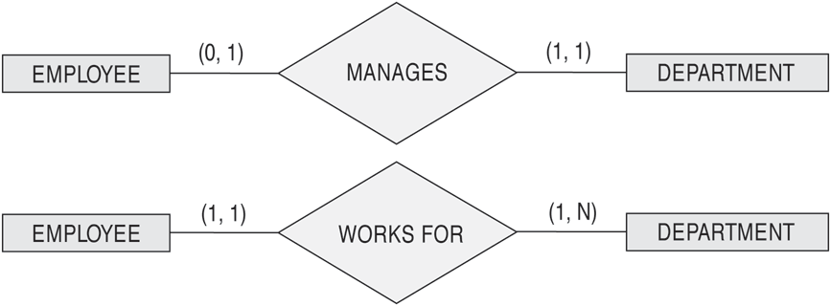
Cardinality Constraints: Method 2
Using (min, max) to specify the participation of an entity set in a relationship set with min≤max, min≥0, max ≥1
Employee
1
Manages
1
Department
Employee
N
WorksFor
1
Department
Notes:
Default(no constraint): min=0, max=n (signifying no limit)

Slide 38
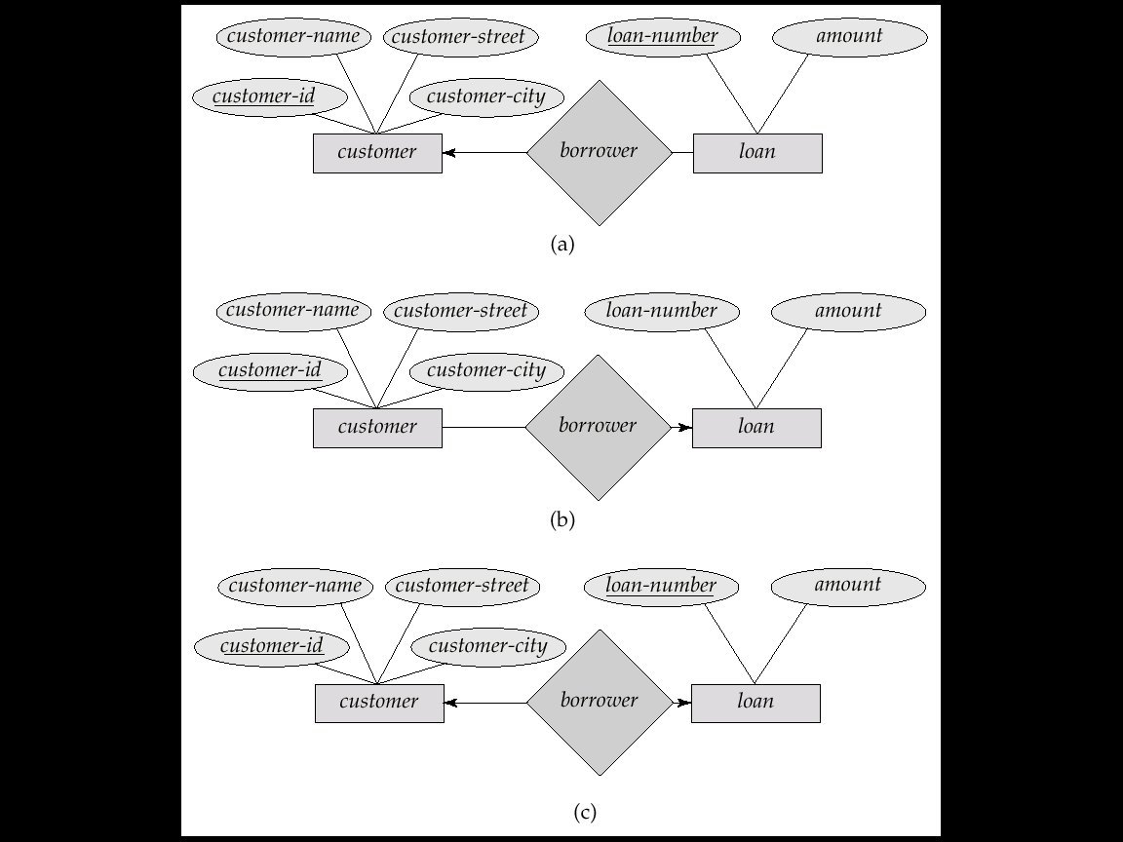
Cardinality Constraints: Method 3
One to one
Partial
Total
Employee
Manages
Department
One
One
One to Many

Slide 39
Ternary Relationship
C#
Name
Course
E#
Name
S#
Name
ISC
Instructor
Student
Grade

Slide 40
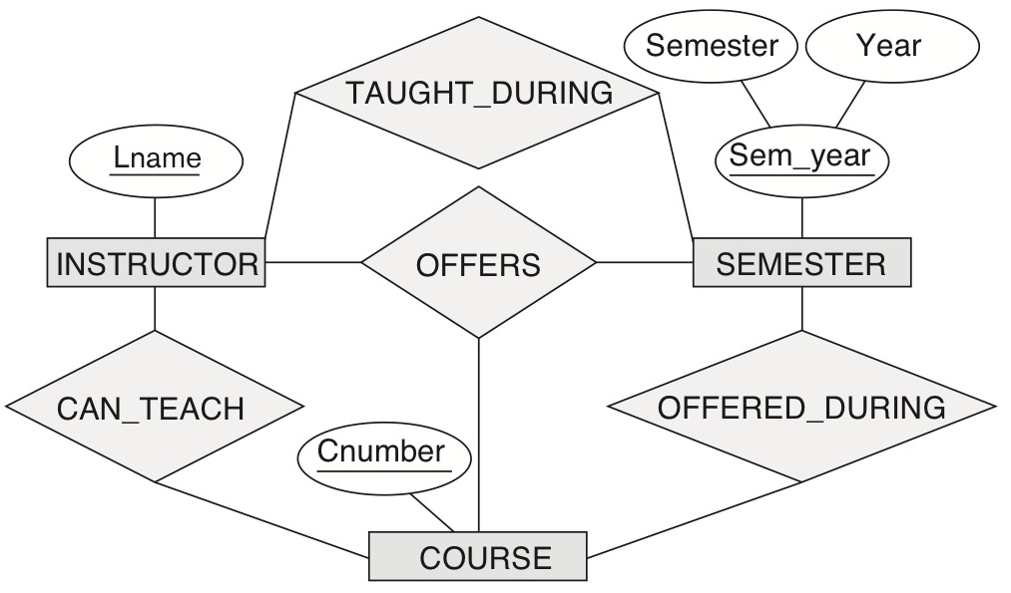
Another example of a ternary relationship
Figure 3.18 Another example of ternary versus binary relationship types.

Slide 41
EER Model
subclasses/superclasses
specialization/generalization
categories (UNION types)
attribute and relationship inheritance

Slide 42
Constraints (3)
Two basic constraints can apply to a specialization/generalization:
Disjointness Constraint:
Completeness Constraint:

Slide 43
ER and EER to RDB Mapping
ER-to-Relational Mapping Algorithm
Step 1: Mapping of Regular Entity Types
Step 2: Mapping of Weak Entity Types
Step 3: Mapping of Binary 1:1 Relation Types
Step 4: Mapping of Binary 1:N Relationship Types.
Step 5: Mapping of Binary M:N Relationship Types.
Step 6: Mapping of Multivalued attributes.
Step 7: Mapping of N-ary Relationship Types.
Mapping EER Model Constructs to Relations
Step 8: Options for Mapping Specialization or Generalization.
Step 9: Mapping of Union Types (Categories).

Slide 44
Impedance Mismatch
Impedance mismatch occurs between the database and application programs.
Applications are represented in ER and EER which have various objects/entities and their relationships
The database only have various tables
Mapping objects to tables and vice versa creates a performance disadvantage when the data are complex.

Slide 45
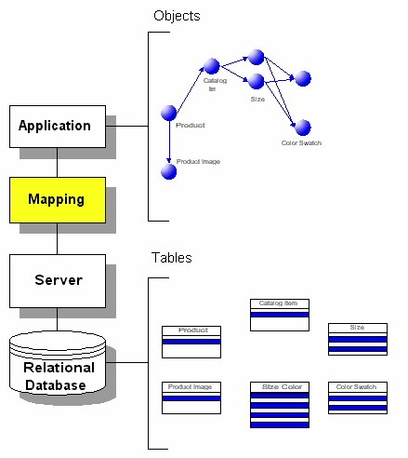
Impedance Mismatch

Slide 46
First Normal Form
Disallows
composite attributes
multivalued attributes
nested relations; attributes whose values for an individual tuple are non-atomic
Considered to be part of the definition of a relation
Most RDBMSs allow only those relations to be defined that are in First Normal Form

Slide 47
Non-First Normal Form (NF2)
First Normal Form disallows
composite attributes
multivalued attributes
nested relations; attributes whose values for an individual tuple are non-atomic
Non-First Normal Form allows
composite attributes
multivalued attributes
nested relations

Slide 48
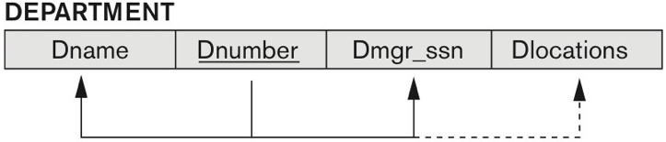
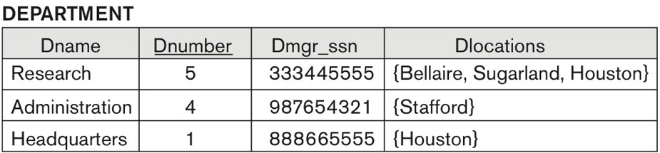
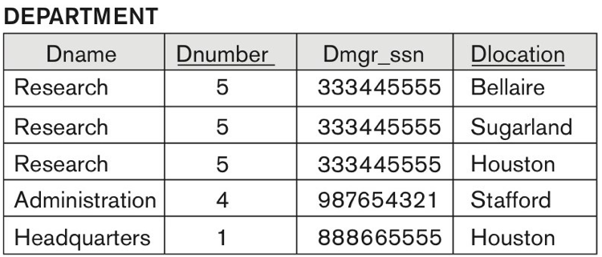
Normalization into 1NF

Slide 49

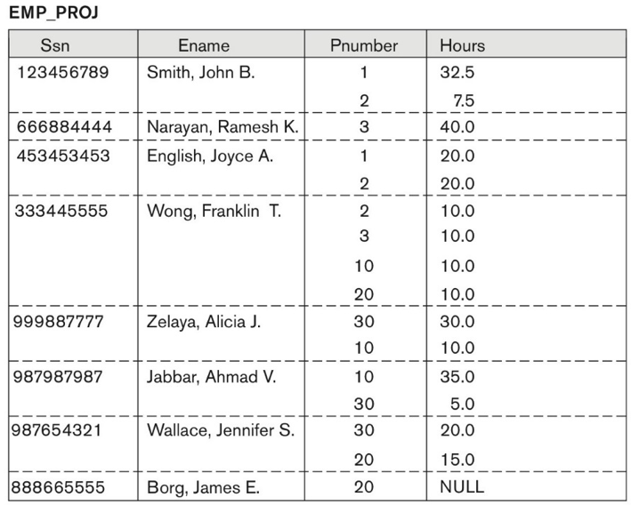
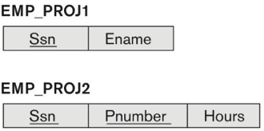
Normalizing nested relations into 1NF

Slide 50
Second Normal Form
A relation schema is in second normal form (2NF) if every non-prime attribute is fully functionally dependent on the primary key
A relation can be decomposed into 2NF relations via the process of 2NF normalization or “second normalization”
Employee
E# | ENAME | AGE | D# | DNAME | LOC
1000 | John | 25 | D1 | CS | MT300
2000 | Kate | 24 | D1 | CS | MT300
3000 | Tony | 24 | D2 | MT | UC231
What FDs exist?
E# → ENAME, AGE, D#
D# → DNAME, LOC

Slide 51
Third Normal Form
A relation schema is in third normal form (3NF) if it is in 2NF and no non-prime attribute is transitively dependent on the primary key
A relation can be decomposed into 3NF relations via the process of 3NF normalization
E# | NAME | DEPT | Mgr
3NF Normalization
E# | ENAME | DEPT
DEPT | MGR

Slide 52
General Definition of 2NF
A relation schema is in second normal form (2NF) if every non-prime attribute is fully functionally dependent on every key
Is the relation in 2NF?
Candidate Key
Lots
Property# | County_Name | Lot# | Area | Price | Tax_Rate
FD1
FD2
FD3
FD4
FD3 violates 2NF.
Lots1
Property# | County_Name | Lot# | Area | Price
Lots2
County_name | Tax_rate
FD1
FD2
FD4
FD3

Slide 53
General Definition of Third Normal Form
A relation schema R is in third normal form (3NF) if whenever a FD X → A holds in R, then either:
(a) X is a superkey of R, or
(b) A is a prime attribute of R
Are the relations in 3NF?
Lots1
Property# | County_Name | Lot# | Area | Price
Lots2
County_name | Tax_rate
FD1
FD2
FD4
FD3
Area is not a superkey in Lots1
3NF Normalization
Lots1A
Property# | County_Name | Lot# | Area
Lots1B
Area | Price
FD1
FD2
FD4

Slide 54
Interpreting the General Definition of 3NF
Consider the 2 conditions in the Definition of 3NF:
A relation schema R is in third normal form (3NF) if whenever a FD X → A holds in R, then either:
(a) X is a superkey of R, or
(b) A is a prime attribute of R
Condition (a) catches two types of violations :
one where a prime attribute functionally determines a non-prime attribute. This catches 2NF violations due to non-full functional dependencies.
second, where a non-prime attribute functionally determines a non-prime attribute. This catches 3NF violations due to a transitive dependency.

Slide 55
BCNF (Boyce-Codd Normal Form)
A relation schema R is in Boyce-Codd Normal Form (BCNF) if whenever an FD X → A holds in R, then X is a superkey of R
Each normal form is strictly stronger than the previous one
Every 2NF relation is in 1NF
Every 3NF relation is in 2NF
Every BCNF relation is in 3NF
There exist relations that are in 3NF but not in BCNF
Hence BCNF is considered a stronger form of 3NF
The goal is to have each relation in BCNF (or 3NF)

Slide 56
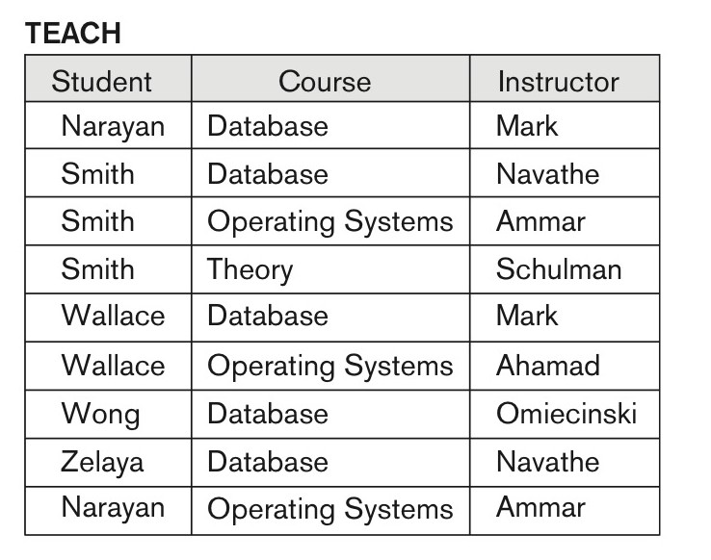
A relation in 3NF but not in BCNF
Figure 14.14
A relation TEACH that is in 3NF but not BCNF.
Student | Course | Instructor
FD1: Student,Course→Instructor
Which Normal Form is it in?
FD2: Instructor → Course
A relation NOT in BCNF should be decomposed
Student
Instructor
1NF?
2NF?
3NF?
BCNF?
Course

Slide 57
Normalization
Functional dependency FD X → Y
Multivalued dependency MVD X → → Y
Join dependency JD(A,B,...)
None-First Normal Form (NF2)
First Normal Form (1NF)
Second Normal Form (2NF)
Third Normal Form (3NF)
Boyce-Codd Normal Form (BCNF)
Fourth Normal Form (4NF)
Fifth Normal Form (5NF)

Slide 58
Database Programming Approaches
Application program is a mixture of host language statements and SQL statements and directives
- (Static) Embedded SQL; standardized
hardcode SQL into program
- Dynamic (Embedded) SQL
can generate flexible SQL queries at run-time
Pre-compilation necessary
translates the embedded SQL statements into
standard runtime library calls, and generates a
modified source program that can be compiled

Slide 59
Embedded SQL
(Static) Embedded SQL; standardized
hardcode SQL into program
Dynamic (Embedded) SQL
Method 1: Execute Immediate
Method 2: DML with Varibles
Method 3: QL with Varibles
Method 4: Any DDL, DML, QL at run-time

Slide 60
Relationship Between Embedded SQLs
Static DDL, DML, QL
Static SQL
execute immediate DDL,DML
Method 1
vars, prepare, execute QL
vars, prepare, execute DDL,DML
Method 3
Method 2
any DDL, DML
any QL
Method 4
Dynamic SQL

Slide 61
Generations of Programming Languages
Each generations provides a higher level of abstraction of the internal computer hardware details, making the language more programmer-friendly, powerful and versatile
1st generation language (1GL)
Machine languages
2nd generation language (2GL)
Assembly languages
3rd generation language (3GL)
High-level procedural programming language: C, Java
4th generation language (4GL)
Declarative in nature such as SQL
Specify what to do rather than how to do:
SELECT * FROM Student;
Simpler to use and have fewer commands
Insulate the user from the data structures and algorithms

Slide 62
Solution
Use the cursor mechanism and special iterators to loop over query results.
A cursor (iterator) specifies a query that may have a set of tuples.
exec sql declare s-cursor cursor for
select s#, sname, age
from student;
exec sql open s-cursor;
…
exec sql close s-cursor;
Client
Client
Network
DBMS
Server
The result is in SQLCA
The result in SQLCA is erased.
Notes:
tells the server that the processing of query results has been completed and result in server memory can be erased

Slide 63

Client-Server Architecture
Application
Program
Client
SQL
SQL
Engine
Server
DB

Slide 64
Problem with the C/S model
The user sends one SQL statement from a client to the server at a time and the server sends back the result
too much data transfer between client and server Fat client/Thin server
better to have the server do more to reduce the traffic Thin client/Fat server
Many applications requires several SQL statements.
Sometimes, procedural constructs such as loop, if-then-else, etc. are needed at the server side to further process the result and generate new queries accordingly
Client
Client
SQL
Network
SQL
DBMS
Server

Slide 65
Transactions
A transaction is a logical unit of work that contains one or more SQL statements (set of operations) and/or other programing constructs
Every transaction is assigned a unique identifier called a transaction ID.
A transaction has a beginning and an end.
The use of transactions is one of the most important ways that a database management system differs from a file system.

Slide 66
What may go wrong?
Transaction failure:
arithmetic overflow
insert a tuple whose values do not conform to its schema
insert/delete/update a tuple whose values violate integrity constrains such as
primary key, foreign key, not null, beyond the range
System crash:
power outage
Media failure:
disk failure

Slide 67
Frequency of failure
Type of Failure Frequency of occurrence
transaction | 0-100 per minute
system | several per month
media | once or twice per year
How to guarantee the correctness of database
operations with hundreds of concurrent users?
Transactions

Slide 68
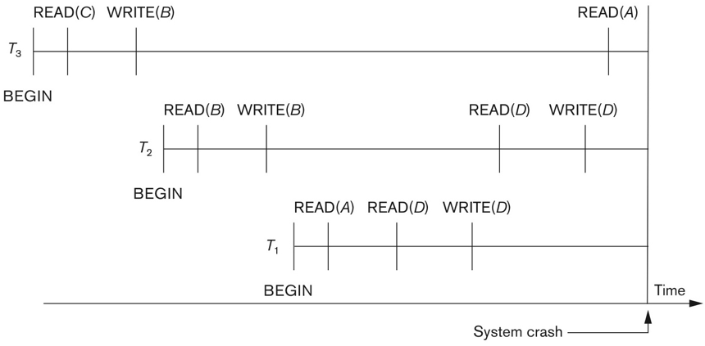
System Crash
Notes:
Figure 22.1c Illustrating cascading rollback (a process that never occurs in strict or cascadeless schedules). Operations before the crash.

Slide 69
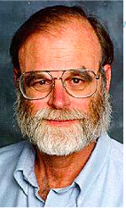
ACID Properties of Transactions
Worked in IBM on various database systems, IMS, System R, SQL/DS, DB2.
Invented transaction processing to make relational database system possible in 1976. i.e., the famous ACID properties.
In 1993, Microsoft wanted to get into relational DB market and got him on MS SQL server 7.0
Received ACM’s Turing Award in 1998 for his work on Transaction Processing when 54
Jim Gray
Jan 12, 1944
Jan 28, 2007
Atomicity
Consistency
Isolation
Durability
ACID properties

Slide 70
Final Examination
Date: Dec 9, 2019 9:00AM
Time: Two hours
Questions: 100
Part 1 True or False (40 questions)
Part 2 Multiple Choice (60 questions)

Slide 71
Instructions
Bring just No. 2 pencil. Nothing else.
It is a closed book exam
Use the Scantron Sheet provided for all questions.
Before you start to do this exam, put your name, course number, student number on the Scantron Sheet.
Submit Scantron Sheets and Exam Papers together

Slide 72

Scantron Sheet

Slide 73
True or False
Basic Concepts
Data Models
Hierarchical, Network, Relational, ER, Nested Relational, Object Relational
Query Languages
ALG, TRC, DRC, QBY, SQL
Normalization and Normal Forms
Embedded/Dynamic SQL, PL/SQL
Database System and Transactions

Slide 74
Multiple Choice
History of DB, Data Models, DB System Hierarchical, Network, Relational, Nested Relational, Object Relational
Relational Model and its languages: ALG, TRC, DRC, QBE, SQL
ER, EER，ER/EER Mapping
Functional/Multivalued Dependancy and Normalization inference, NF2, 1NF, 2NF, 3NF, BCNF, 4NF, 5NF
Database Programming: Embeded/Dynamic SQL

